Slide 1

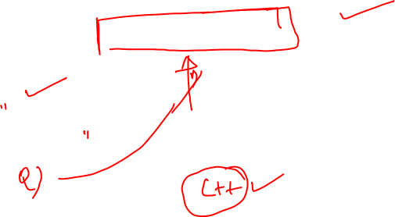
Solve using Classes & Objects in C++ Programming
Best Student

Slide 2

Classes & Objects
Classes and Objects are basic concepts of Object Oriented Programming which revolve around the real life entities.
A class is a user defined blueprint or prototype from which objects are created.
It represents the set of properties or methods that are common to all objects of one type.

Slide 3


Slide 4
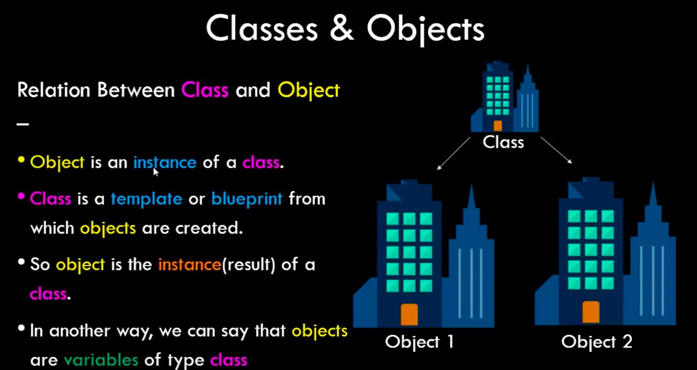


Slide 5
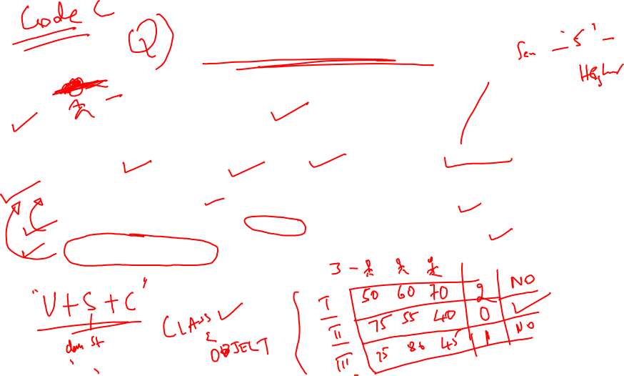
Best student
“Kristen is a contender for BEST STUDENT of her high school. She wants to know how many students (if any) have scored higher than her in the 5 exams given during this semester”
Create a class named STUDENT with the following specifications:
An instance variable named SCORES to hold a student’s 5 exam scores.
A void input() function that reads 5 integers and saves them to SCORES.
An int calculateTotalScore() function that returns the sum of the student's scores.

Slide 6
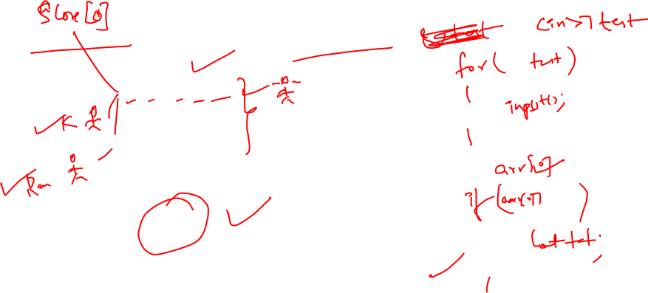
Sample I/O
Input
3
10 10 10 10 10
20 20 20 20 20
30 30 30 30 30
Output
2

Slide 7
C++ CODE
#include <iostream>
using namespace std;
class Student
{
public:
int arr[5], sum=0;
void input()
{
for(int i=0;i<5;i++)
{
cin>>arr[i];
}
}
int calculateTotalScore()
{
for(int i=0;i<5;i++)
{
sum=sum+arr[i];
}
return sum;
}
};
int main()
{
int n;
cin >> n;
Student *s = new Student[n];
for(int i = 0; i < n; i++)
{
s[i].input();
}
int kristen_score = s[0].calculateTotalScore();
int count = 0;
for(int i = 1; i < n; i++)
{
int total = s[i].calculateTotalScore();
if(total > kristen_score)
{
count++;
}
}
cout << count;
return 0;
}

Slide 8
Thank You

